Slide 1


Python Coding Session Operators and Data type conversion
Introduction to Implementation Details and Usage

Slide 2

Introduction
Operators in Python are symbols or keywords used to perform operations on variables and values. Python provides a wide range of operators that serve different purposes, including arithmetic operators (+, -, *, /), logical operators (and, or, not), comparison operators (>, <, ==, !=), assignment operators (=, +=, -=), and more. The Data type conversion consist in functions that allow you to change the data type of one object.

Slide 3
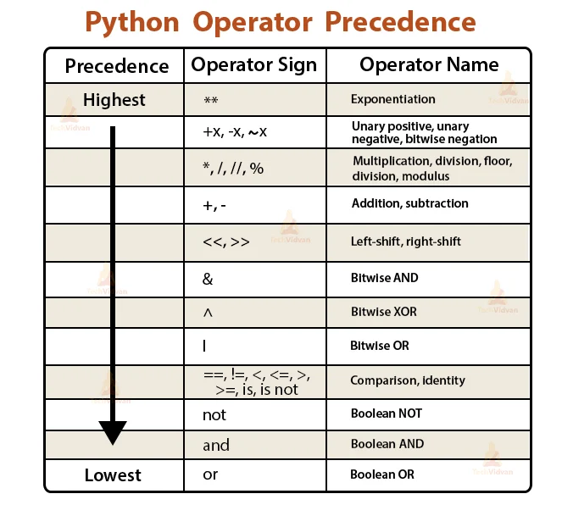
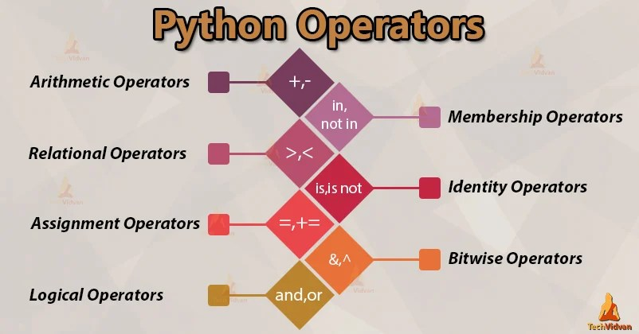
Python Operators

Slide 4
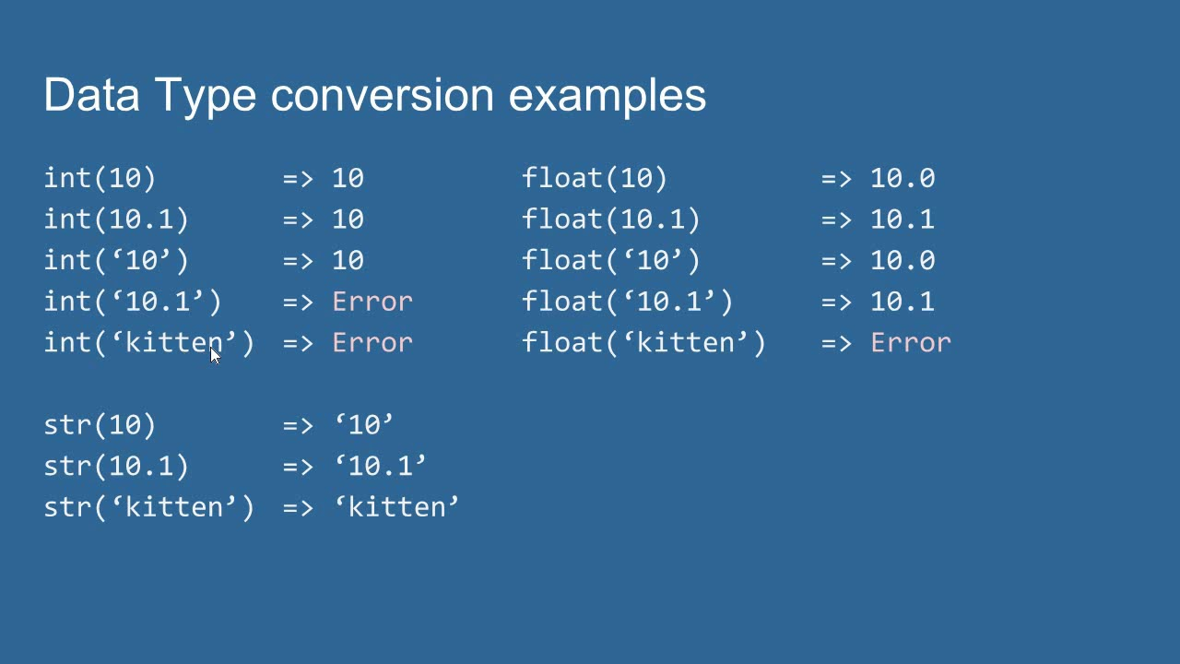
Data Conversion

Slide 5
Pratice Operators
Exercise 1: Arithmetic Operations, Write a program that prompts the user to enter two numbers and performs the following operations:
Add the two numbers and display the result.
Subtract the second number from the first number and display the result.
Multiply the two numbers and display the result.
Divide the first number by the second number and display the result.
Calculate the remainder when the first number is divided by the second number and display the result. Do it using data type conversion
Exercise 2: Write a program that prompts the user to enter two strings and compare if they are equal

Slide 6
Pratice
Exercise 3: String Concatenation Write a program that prompts the user to enter their first name and last name, and then concatenates them together with a space in between. Display the full name using appropriate operators.
Exercise 4: Conversion Calculation Write a program that prompts the user to enter a length in meters and converts it to centimeters, inches, and feet. Display the converted values using appropriate operators. Do it using data type conversion.

